Slide 1
Minimum Edit Distance
Definition of Minimum Edit Distance

Slide 2
How similar are two strings?
Spell correction
  The user typed “graffe”
  Which is closest?
    graf
    graft
    grail
    giraffe
Computational Biology
  Align two sequences of nucleotides
  Resulting alignment:
AGGCTATCACCTGACCTCCAGGCCGATGCCC
TAGCTATCACGACCGCGGTCGATTTGCCCGAC
-AGGCTATCACCTGACCTCCAGGCCGA--TGCCC---
TAG-CTATCAC--GACCGC--GGTCGATTTGCCCGAC
Also for Machine Translation, Information Extraction, Speech Recognition

Slide 3
Edit Distance
The minimum edit distance between two strings
Is the minimum number of editing operations
  Insertion
  Deletion
  Substitution
Needed to transform one into the other

Slide 4
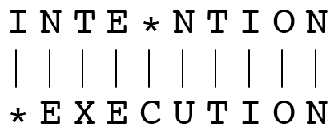
Minimum Edit Distance
Two strings and their alignment:

Slide 5
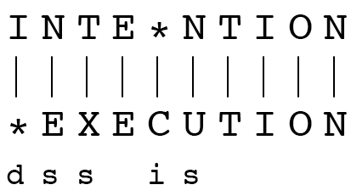
Minimum Edit Distance
If each operation has cost of 1
  Distance between these is 5
If substitutions cost 2 (Levenshtein)
  Distance between them is 8

Slide 6
Alignment in Computational Biology
Given a sequence of bases
An alignment:
Given two sequences, align each letter to a letter or gap
AGGCTATCACCTGACCTCCAGGCCGATGCCC
TAGCTATCACGACCGCGGTCGATTTGCCCGAC
-AGGCTATCACCTGACCTCCAGGCCGA--TGCCC---
TAG-CTATCAC--GACCGC--GGTCGATTTGCCCGAC

Slide 7
Other uses of Edit Distance in NLP
Evaluating Machine Translation and speech recognition
R Spokesman confirms senior government adviser was shot
H Spokesman said the senior adviser was shot dead
S I D I
Named Entity Extraction and Entity Coreference
  IBM Inc. announced today
  IBM profits
  Stanford President John Hennessy announced yesterday
  for Stanford University President John Hennessy

Slide 8
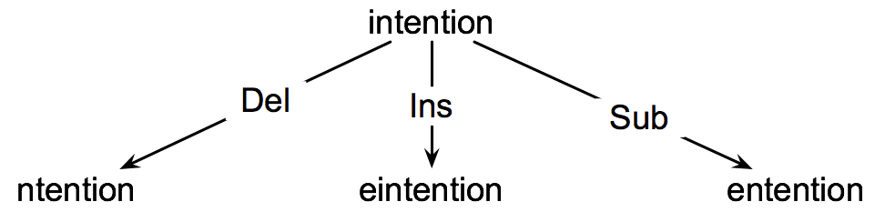
How to find the Min Edit Distance?
Searching for a path (sequence of edits) from the start string to the final string:
  Initial state: the word we’re transforming
  Operators: insert, delete, substitute
  Goal state: the word we’re trying to get to
  Path cost: what we want to minimize: the number of edits

Slide 9
Minimum Edit as Search
But the space of all edit sequences is huge!
  We can’t afford to navigate naïvely
  Lots of distinct paths wind up at the same state.
    We don’t have to keep track of all of them
    Just the shortest path to each of those revisted states.

Slide 10
Defining Min Edit Distance
For two strings
  X of length n
  Y of length m
We define D(i,j)
  the edit distance between X[1..i] and Y[1..j]
    i.e., the first i characters of X and the first j characters of Y
  The edit distance between X and Y is thus D(n,m)

Slide 11
Minimum Edit Distance
Definition of Minimum Edit Distance

Slide 12
Minimum Edit Distance
Computing Minimum Edit Distance

Slide 13
Dynamic Programming for
Minimum Edit Distance
Dynamic programming: A tabular computation of D(n,m)
Solving problems by combining solutions to subproblems.
Bottom-up
  We compute D(i,j) for small i,j
  And compute larger D(i,j) based on previously computed smaller values
  i.e., compute D(i,j) for all i (0 < i < n) and j (0 < j < m)

Slide 14
Defining Min Edit Distance (Levenshtein)
Initialization
  D(i,0) = i
  D(0,j) = j
Recurrence Relation:
  For each i = 1…M
  For each j = 1…N
  D(i-1,j) + 1
  D(i,j)= min D(i,j-1) + 1
  D(i-1,j-1) + 2 ; if X(i) ≠ Y(j)
  0 ; if X(i) = Y(j)
Termination:
  D(N,M) is distance

Slide 15
The Edit Distance Table
N | 9
O | 8
I | 7
T | 6
N | 5
E | 4
T | 3
N | 2
I | 1
# | 0 | 1 | 2 | 3 | 4 | 5 | 6 | 7 | 8 | 9
 | # | E | X | E | C | U | T | I | O | N

Slide 16
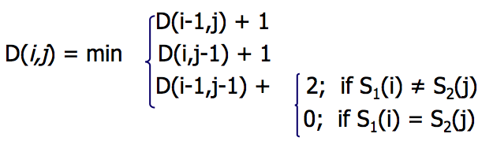
The Edit Distance Table
N | 9
O | 8
I | 7
T | 6
N | 5
E | 4
T | 3
N | 2
I | 1
# | 0 | 1 | 2 | 3 | 4 | 5 | 6 | 7 | 8 | 9
 | # | E | X | E | C | U | T | I | O | N

Slide 17
Edit Distance
N | 9
O | 8
I | 7
T | 6
N | 5
E | 4
T | 3
N | 2
I | 1
# | 0 | 1 | 2 | 3 | 4 | 5 | 6 | 7 | 8 | 9
 | # | E | X | E | C | U | T | I | O | N

Slide 18
The Edit Distance Table
N | 9 | 8 | 9 | 10 | 11 | 12 | 11 | 10 | 9 | 8
O | 8 | 7 | 8 | 9 | 10 | 11 | 10 | 9 | 8 | 9
I | 7 | 6 | 7 | 8 | 9 | 10 | 9 | 8 | 9 | 10
T | 6 | 5 | 6 | 7 | 8 | 9 | 8 | 9 | 10 | 11
N | 5 | 4 | 5 | 6 | 7 | 8 | 9 | 10 | 11 | 10
E | 4 | 3 | 4 | 5 | 6 | 7 | 8 | 9 | 10 | 9
T | 3 | 4 | 5 | 6 | 7 | 8 | 7 | 8 | 9 | 8
N | 2 | 3 | 4 | 5 | 6 | 7 | 8 | 7 | 8 | 7
I | 1 | 2 | 3 | 4 | 5 | 6 | 7 | 6 | 7 | 8
# | 0 | 1 | 2 | 3 | 4 | 5 | 6 | 7 | 8 | 9
 | # | E | X | E | C | U | T | I | O | N

Slide 19
Minimum Edit Distance
Computing Minimum Edit Distance

Slide 20
Minimum Edit Distance
Backtrace for Computing Alignments

Slide 21
Computing alignments
Edit distance isn’t sufficient
  We often need to align each character of the two strings to each other
We do this by keeping a “backtrace”
Every time we enter a cell, remember where we came from
When we reach the end,
  Trace back the path from the upper right corner to read off the alignment

Slide 22
Edit Distance
N | 9
O | 8
I | 7
T | 6
N | 5
E | 4
T | 3
N | 2
I | 1
# | 0 | 1 | 2 | 3 | 4 | 5 | 6 | 7 | 8 | 9
 | # | E | X | E | C | U | T | I | O | N

Slide 23
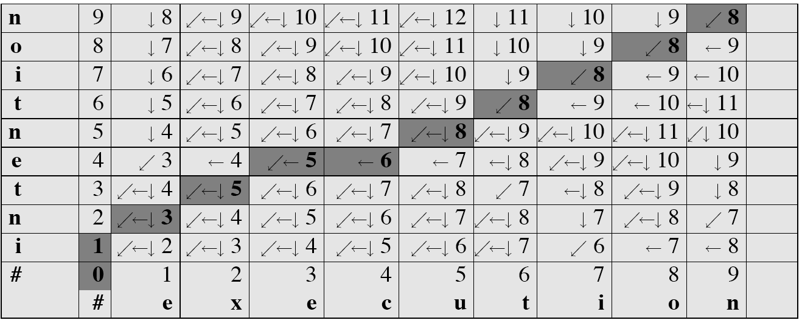
MinEdit with Backtrace

Slide 24
Adding Backtrace to Minimum Edit Distance
Base conditions: Termination:
  D(i,0) = i D(0,j) = j D(N,M) is distance
Recurrence Relation:
  For each i = 1…M
  For each j = 1…N
  D(i-1,j) + 1
  D(i,j)= min D(i,j-1) + 1
  D(i-1,j-1) + 2; if X(i) ≠ Y(j)
  0; if X(i) = Y(j)
  LEFT
  ptr(i,j)= DOWN
  DIAG
deletion
insertion
substitution
insertion
deletion
substitution

Slide 25
The Distance Matrix
Every non-decreasing path
from (0,0) to (M, N)
corresponds to
an alignment
of the two sequences
x₀ …………………… x_{N}
An optimal alignment is composed of optimal subalignments
y₀ ……………………………… y_{M}

Slide 26
Result of Backtrace
Two strings and their alignment:

Slide 27
Performance
Time:
  O(nm)
Space:
  O(nm)
Backtrace
  O(n+m)

Slide 28
Minimum Edit Distance
Backtrace for Computing Alignments

Slide 29
Minimum Edit Distance
Weighted Minimum Edit Distance

Slide 30
Weighted Edit Distance
Why would we add weights to the computation?
  Spell Correction: some letters are more likely to be mistyped than others
  Biology: certain kinds of deletions or insertions are more likely than others

Slide 31
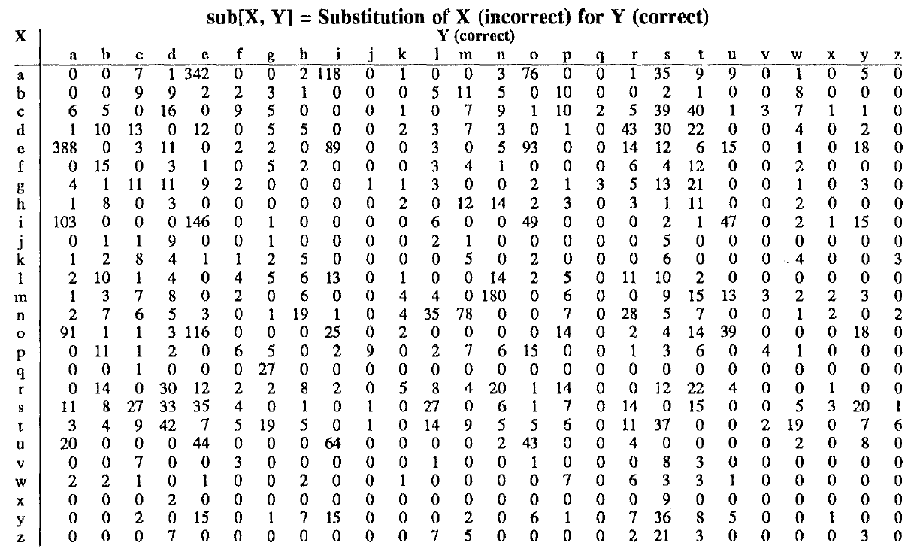
Confusion matrix for spelling errors

Slide 32
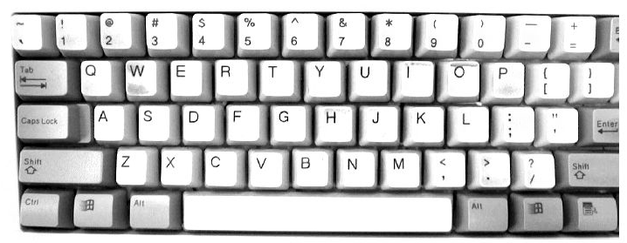

Slide 33
Weighted Min Edit Distance
Initialization:
  D(0,0) = 0
  D(i,0) = D(i-1,0) + del[x(i)]; 1 < i ≤ N
  D(0,j) = D(0,j-1) + ins[y(j)]; 1 < j ≤ M
Recurrence Relation:
  D(i-1,j) + del[x(i)]
  D(i,j)= min D(i,j-1) + ins[y(j)]
  D(i-1,j-1) + sub[x(i),y(j)]
Termination:
  D(N,M) is distance

Slide 34
Where did the name, dynamic programming, come from?
…The 1950s were not good years for mathematical research. [the] Secretary of Defense …had a pathological fear and hatred of the word, research…
I decided therefore to use the word, “programming”.
I wanted to get across the idea that this was dynamic, this was multistage… I thought, let’s … take a word that has an absolutely precise meaning, namely dynamic… it’s impossible to use the word, dynamic, in a pejorative sense. Try thinking of some combination that will possibly give it a pejorative meaning. It’s impossible.
Thus, I thought dynamic programming was a good name. It was something not even a Congressman could object to.”
Richard Bellman, “Eye of the Hurricane: an autobiography” 1984.

Slide 35
Minimum Edit Distance
Weighted Minimum Edit Distance

